Slide 1
The Oracle SOA Platform
Focus on ESB, BPEL, OWSM, BAM, Rules
Robin Zimmermann
Principal Product Manager
Oracle Integration

Slide 2
The Oracle SOA Platform
SOA, Web services, BPEL and 100% standard integration approaches extend the reach of the application server platform to service-based, process-centric applications.
Agenda
Key SOA Standards
Oracle Integration / SOA Platform
Adapters, ESB, BPEL, OWSM, BAM, Rules
Other SOA Suite components
SOA Order Booking Demo
  ESB, BPEL, Rules, OWSM

Slide 3

Important Standards for SOA
ERP/
Legacy Apps
Portal
Security
Reliability
Logging
Failover
Dynamic Routing
Custom Apps
& Services
Web Application
Monitoring
Optimization
Process Flow
Logic
WS
API
Web services
MONITOR & OPTIMIZE
INTERACT/ACCESS
ORCHESTRATE
GATEWAY
BUSINESS SERVICES
BAM
PORTAL JSR-168
BPEL
WS-Security
XML/XML Schema
JMX
Struts/JSF
XSLT/XQuery
WS-Policy, SAML
WSDL/WSIF
Web Services Mgmt
SOAP
JCA
JMS

Slide 4
The Oracle SOA Technologies
BPA Suite
BAM
BI
Enterprise Manager
MANAGEMENT
&
MONITORING
Analyst
Tools
ROUTING & ORCHESTRATION
Events
Business
Monitoring
Analytics
System
Monitoring
GOVERNANCE
JDeveloper
BPEL Process Manager
Web Services Manager
Native
BPEL
Human
Workflow
Business
Rules
Management
App Dev
Framework
DATA SERVICES & CONNECTIVITY
Enterprise Service Bus
Multi
Protocol
XSLT
Transform
Routing
Security
Metadata Repository
Adapters
ODI
B2B
SES
Registry
Apps
DB
Bulk
ETL
Partners
RFID
Discovery
Policies
J2EE Application Server
Oracle AS, JBoss, WebLogic, WebSphere
Messaging
Notes:
Oracle SOA Suite is a complete set of service infrastructure components for creating, deploying, and managing SOAs. Oracle SOA Suite enables services to be created, managed, and orchestrated into composite applications and business processes. Better, you can adopt it incrementally on a project by project basis and still benefit from the common security, management, deployment architecture, development tools, etc. that you get out of the box.
Oracle SOA Suite consists of Oracle's most popular, best-of-breed technologies including:
J2EE:
=========================
Oracle JDeveloper 10g: a comprehensive integrated SOA development environment for creating and composing applications that also acts as a unified toolset for all components in the Oracle SOA Suite.
CONNECTIVITY:
=========================
Adapters
B2B
SES
ROUTING & ORCHESTRATION:
=========================
Oracle Enterprise Service Bus: a standards-based multi-protocol bus to virtualize endpoints as services
Oracle BPEL Process Manager: the first native business process execution language (BPEL) engine for Web services orchestration enabling you to design, define and execute business processes.
Oracle Business Rules Engine: enables agile management of business rules.
GOVERNANCE:
=========================
Oracle Web Services Manager: a single console to secure and manage your Web services.
UDDI Registry
MANAGEMENT & MONITORING:
=========================
Oracle Business Activity Monitoring: delivers real-time insight into business operations.
Oracle Services Registry: a best of breed UDDI v3 registry.
END-USER DESIGN TOOLS:
=========================
JDeveloper for Developers and Integrators
BPA Suite for Business Analysts
Oracle SOA Suite is compatible with other middleware platforms including Oracle Fusion Middleware, IBM WebSphere, BEA WebLogic, and JBoss Application Server.

Slide 5
Broad Adoption…
Financial Services Order/Payment Processing
New Account Provisioning Process
Trade Exception Management
High Tech Order Management
Trading Partner Integration
Telecom Cell Phone Activation
VoIP Provisioning
DSL Provisioning
Government Medicare Eligibility Determination and Enrollment
Satellite Data Exchange
Publish and Process Forms
Employee On-boarding
Transportation Fleet and Asset Management
Travel Reservations
Retail Sales Data Integration

Slide 6
Oracle SOA Platform Drill-down
JDeveloper
  Complete IDE, J2EE, Web services, Supports WSIF Bindings
Adapters
  Connectivity to 300+ back-end systems, visual design, JCA
Oracle ESB
  Messaging, connectivity and data distribution
Oracle Web Services Manager
  Service intermediation, security and policy management
Oracle BPEL PM
  Standards based orchestration, workflow management
Oracle BAM
  Application Monitoring, SLA, KPI management
Oracle Business Rules
  Engine, repository, rules editor
Oracle App Server
  Full featured J2EE deployment, scalability, reliability, HA

Slide 7
Adapters
Unlocking your information assets

Slide 8


Information Fragmentation……
Oracle, Informix, DB2, MSSQL, Sybase
Delimited, Positional, Cobol copy book, DTD, XSD, PDF, PS, excel, unstructured
documents
Database
Oracle Applications, Peoplesoft,
Siebel, J.D.Edwards
Files
Packaged
Oracle AS
Adapters
Messaging
Middleware
Legacy
JMS, AQ, OC4J
JMS, IBM MQSeries,
TIBCO Rendezvous
Multimedia
Tuxedo, VSAM, IMS/TM,
IMS/DB, CICS
Email, Voice mail, Video

Slide 9
Oracle Adapters
Enterprise-strength infrastructure for connectivity to enterprise information systems (EIS).
Comprehensive and Pervasive connectivity
Support for SOA /EDA
Open Standards Support
Hot Pluggable
Rapid development
Robust & highly scalable.
Managed through Oracle Application Server 10^{g}
Adapter
Design-time
(Jdeveloper)
OracleAS Adapters
BAM
Technology
PORTAL
WSDL
Legacy Application
Native
Interfaces
ESB
Packaged
Application
BPEL PM
JCA
Oracle Applications
J2EE
Applications
J2EE Application Server
(Oracle Application Server & 3rd party
Application Servers)

Slide 10
Some of the Adapters Available for Oracle SOA Suite…
Applications
Oracle Applications
SAP R/3, mySAP
Peoplesoft
JD Edwards
Siebel
Clarify
Lotus Notes
Ariba
AXIOM mx/open
Baan
BroadVision
Clarify
Commerce One
Hogan Financials
i2 Technologies
Lawson
Livelink
Manugistics
Microsoft CRM
Vantive
Walker Interactive
Remedy
Salesforce.com
Databases
Oracle 8i and above
IBM DB/2
Informix
Clarion
Clipper
Cloudscape
DBASE
Dialog
Essbase
FOCUS Data Access
Great Plains
Microsoft SQL Server
MUMPS (Digital Standard MUMPS)
Navision Financials (ODBC 3.x)
Nucleus
Paradox
Pointbase
PROGRESS
Red Brick
RMS
SAS Transport Format
Sybase
Teradata
Unisys DMS 1100/2200
UniVerse
Technology
SOAP
HTTP, HTTP-S
Email – POP3, SMTP, IMAP
FTP, FTP-S
Flat Files
LDAP
JMS
Oracle AQ
IBM MQSeries
TIBCO Rendezvous
Socket
Legacy
CICS
IMS/DB
IMS/TM
VSAM
ADABAS
Natural
Tuxedo
CA-Datacom
Screen Scraping
CA-IDMS
C-ISAM,D-ISAM,K-SAM, QSAM
Notes:
Coding:
Bold == Bundled
Green == Sold as an option, direct from Oracle
Normal text == Available through certified partners

Slide 11
Enterprise Service Bus
Moving data

Slide 12



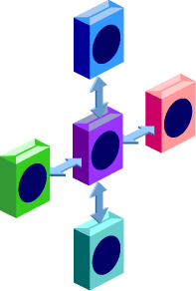



Integrate Services
Routing
QOS
BPEL
Transform
Rules
Enterprise Service Bus
WSIF
In Memory
REST
JCA
COM+
SOAP

Slide 13





Core Features of an ESB
Connects
adapters, web services
Transports
over JMS, HTTP
Routes
based on content/header
Translates
protocols & formats
Virtualizes
services

Slide 14
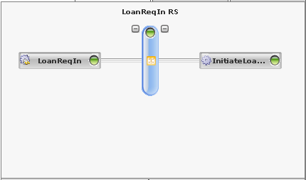
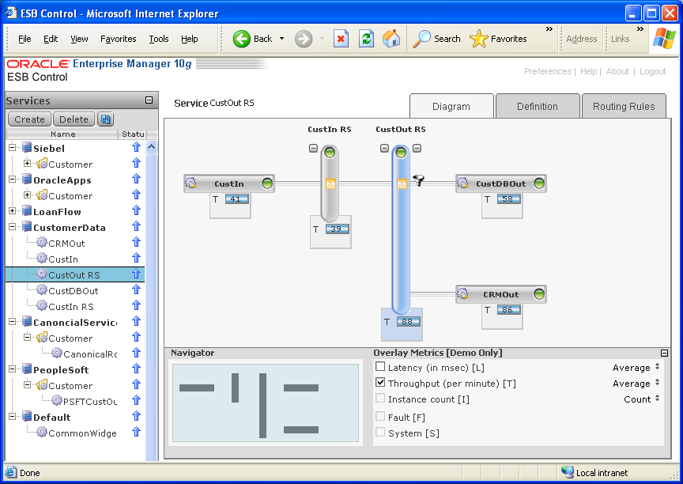
ESB Pattern Summary
Point To Point
  Adapter -> Transformation -> Adapter
  Quick and Easy Integration
  File to DB, Topic to Queue
Canonical Model
  Integrate n+ Enterprise Applications
  Domain Value Mapping
  Dynamically Add New Subscribers
Routing Service
  Decoupled Flexible Routing
  Configurable in Rich Client
  Services Visible to BPEL, BAM, WSM

Slide 15
Oracle BPEL Process Manager
Business Process Orchestration

Slide 16
Introduction to BPEL
Markup language for composing a set of discrete services into an end-to-end process flow
10+ years of research and development from Microsoft (XLANG) and IBM (WSFL, FDML)
The best integration solution for XML and Web services but also Java, JCA and JMS.
Rich support for async interactions, parallel processing and exception management.
Leverages XML Schema, XSLT, XML Query,
WS-Security, WS-Addressing and WSIF.
Composability: A process flow is automatically
a service.
“
Gartner believes that BPEL will emerge as the leading industry standard for Web service orchestration and coordination of business processes.
- David Smith, Research Vice President and fellow, Gartner
”
“
BPEL is the future of the integration space in my view…Why? Because the value is so much higher when you provide not only a way to integrate applications, but also a way to create services from them and put them into business processes
- John Rymer, Vice President, Forrester Research, Inc.
”

Slide 17
BPEL, The Orchestrator
PORTAL
Web Service
Java Service
?
Database
Stored Procedures
J2EE
ERP
SAP, Oracle, etc.
BPEL
User Tasks
TOMCAT
IU

Slide 18



Workflow as a Service
WSDL Contract
Workflow Service
Assign
Task
Task
Complete
Update
Task
Worklist
BPEL
Process
assign tasks to a user/role
wait for task completion as part of an end to end process flow

Slide 19










Human Workflow Features
Task assignment to Users, roles, groups
(OID, LDAP, JAZN, custom plug-ins)
Task routing –
various flow patterns and
assignment rules
Escalation and Delegation rules
Notification to users/groups -
Email, Voice, Pager, SMS …
Customizable Worklist, Task forms, attachments
Task History and Audit,
Productivity Reports

Slide 20
The Oracle BPEL Process Manager
Enterprise-strength infrastructure for designing, deploying and managing BPEL business processes.
JDeveloper
Comprehensive and native
BPEL implementation
Easy-to-use modeling tool
Scalable and reliable engine
Flexible binding framework
Rich management and
monitoring
Support for Oracle AS, JBoss,
WebLogic and WebSphere
Get up and running in less
than 15 minutes!
BPEL Designer
BPEL
BPEL Process Manager
WSDL Binding
Built-in Integration Services
Web services
Dehydration Store
(Oracle Database)
Java, JMS
JAVA
XSLT
Rich Workflow
Sensors
File, FTP
Core BPEL Engine
Database
Apps
BPEL Console
MANAGE
J2EE Application Server
(Oracle AS, WebLogic, JBoss, WebSphere)

Slide 21
Oracle Web Services Manager
Securing Processes and Services in a Policy-Oriented Fashion
http://owsm.us.oracle.com

Slide 22
Web Services Security and Management Concerns
Security
  “We have many web services exposed to the Internet now”
  “Only valid partners may access our web services”
Exception Handling
  “Notify operations if a transaction stalls”
  “Send any incomplete orders to customer service for fixing”
Compliance and Consistency
  “All customer orders must be encrypted with 128 bit keys”
  “All XML messages must follow this format”

Slide 23
A Typical BPEL Example
BPEL Flow
10:00am
start
Credit Rating
Get Rating
Handle Negative
Credit Exception
Send Loan Application
Send Loan Application
United Loan
Star Loan
Receive Loan Offer
Receive Loan Offer
?
Select Lowest Offer
end
03:00pm

Slide 24

What Are the Security Requirements?
Limit who can initiate loan applications
Encrypt SSN
BPEL Flow
BPEL Flow
10:00am
<SSN>
011-22-4488
</SSN>
start
Credit Rating
Get Rating
Get Rating
Handle Negative
Credit Exception
Send Loan Application
Send Loan Application
United Loan
Star Loan
Receive Loan Offer
Receive Loan Offer
Callback has to go through firewall
?
Select Lowest Offer
Make sure no other sensitive data is unprotected
end
03:00pm

Slide 25
BPEL+ Oracle Web Services Manager
Add Oracle WSM
Gateways/Agents
SAML: Role-based access control
WS-Security: Authentication & auto-encryption of SSN in XML message
BPEL Flow
start
10:00am
Credit Rating
Get Rating
Handle Negative
Credit Exception
Send Loan Application
Send Loan Application
United Loan
Star Loan
Receive Loan Offer
Receive Loan Offer
Web services Management: Service virtualization in DMZ
?
Select Lowest Offer
WS-Policy: System-wide service auditing
end
03:00pm

Slide 26
Web Service Management
Decouples Security and Management Policies from Service Logic
Without WSM, policy is hard-coded into each Web Service
Result is siloed, inconsistent security and management
A change in enterprise standards = rework of every service
Higher cost, more fragile, harder to change
No unified insight into operations across services
Slide <number>

Slide 27





Oracle WSM Components
ENFORCE
Policies
Deployment as Gateway Process or as Embedded Agents
BUILD
Policies
MONITOR
Policies
Policy
Gateway
Policy
Agents
Policy
Manager
Oracle Enterprise
Manager
Web Services
Slide <number>

Slide 28
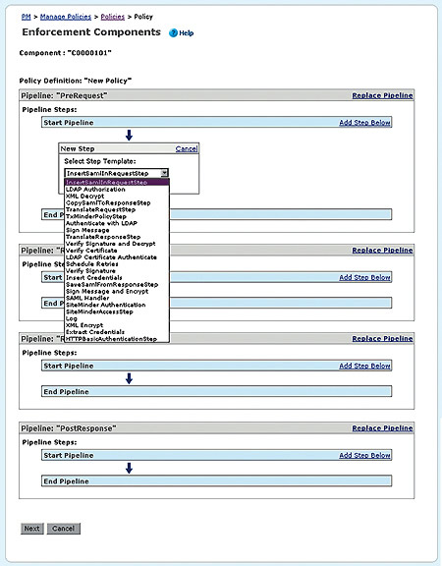
Policy Pipelines
Use Oracle WSM Policy Manager to configure the set of operational polices (pipeline) you want enforced for a given service
Automatically upload the pipeline into the WSM Agent or Gateway responsible for controlling that service
Custom policies can be added and made available to administrators through this same interface
Enforces both enterprise-wide and local best practices

Slide 29
Some Policy Steps…
WS-Security
Decrypt and Verify Signature
Sign Message
Sign Message and Encrypt
XML Decrypt
XML Encrypt
Authorization
COREid Authorize
Active Directory Authorize
File Authorize
LDAP Authorize
SiteMinder Authorize
Credential Management
Extract Credentials
Insert WSBASIC Credentials
Transport-specific QoS
HTTP Messenger
MQ Messenger
JMS Messenger
Authentication
Active Directory Authenticate
File Authenticate
LDAP Authenticate
LDAP Certificate Authenticate
COREid Authenticate
SiteMinder Authenticate
Verify Certificate
Verify Signature
SAML
SAML Copy Token
SAML Insert Token
SAML Save Token
SAML Validate Token
Others
Content-based routing
XML Transform
Logging
Data gathering (SLA, Metering)

Slide 30
Oracle BAM
Business Activity Monitoring
Real-Time Dashboards, Analytics & Alerting
http://bam.us.oracle.com

Slide 31
The Business Problem
Business KPIs report historical, not real-time news
  Information received could be too late to take corrective actions
  Corrective action taken in the moment on historic data might be inaccurate
Operations managers lack the visibility to proactively manage SLA targets
  Poor visibility into leading indicators of problems
  No ability for front line workers to take corrective actions as soon as possible
Inefficient Processes
  No method to identify or track bottlenecks
  Cannot dynamically shift workloads
Monitoring large number of processes
  How can you get a bird’s-eye view of your hundreds or thousands of processes?

Slide 32








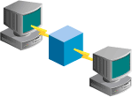


Challenge #1 – Capture Real-Time Data
Business Apps
Business Events, state transitions
Business Processes (BPEL)
Monitoring activities, states
RFID and Sensors
Active and Passive
Location, Temperature, Moisture, Motion, etc.
System Management
Performance metrics, alerts, logs
Messaging Systems
JMS, TIBCO, MQSeries
Security
Authentication, authorization, audit trail
Database
Streams

Slide 33
Challenge #2 – Analyze Processes, Trends, and Context
Monitor a Single Process
 Track each process step
 Identify failures
Process Aggregations
 Averages, KPIs, SLAs
 Identify bottlenecks
Complex Event Processing
 Correlate independent events
 Identify threats & opportunities
Context
 Historical performance
 Rolling average
Jan ‘04
Jan ‘05
Past 4
Hours

Slide 34
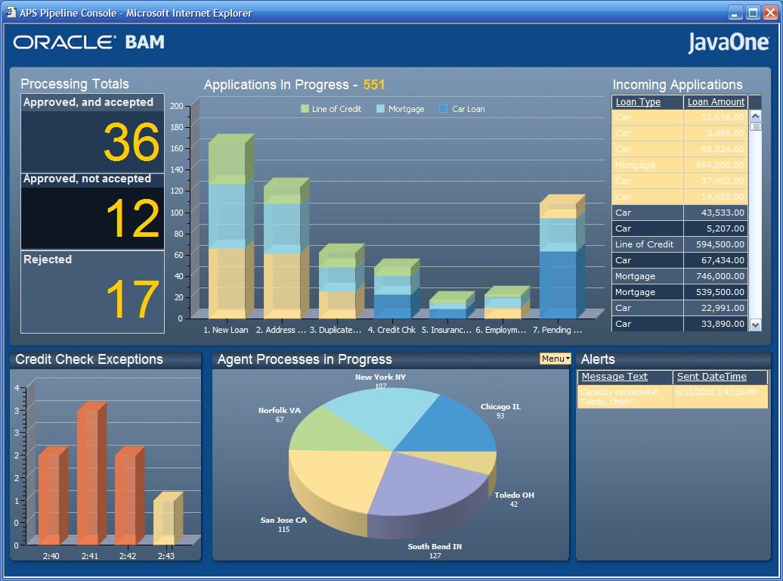
Challenge #3 – Deliver Information to Business Users
Real-Time KPIs
Thin Browser GUI
Role-Based Access
Live Display Technology
Portal Compatible
Embedded Actions

Slide 35
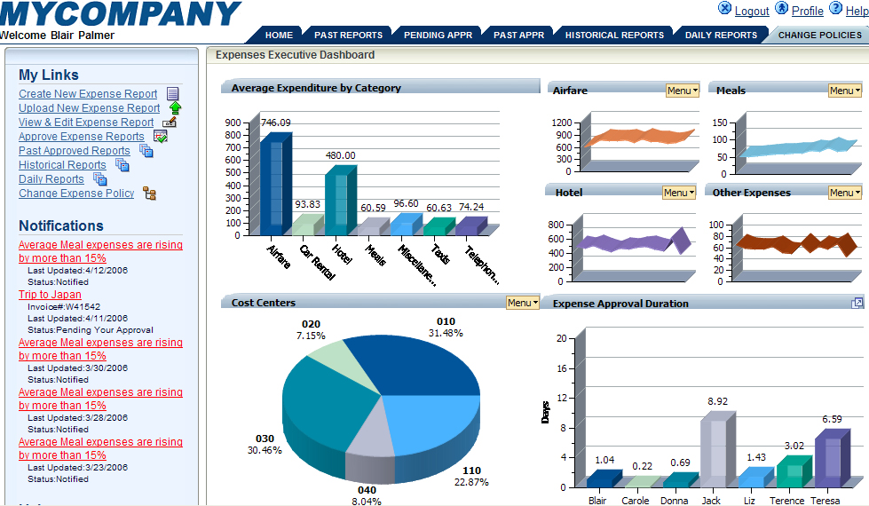
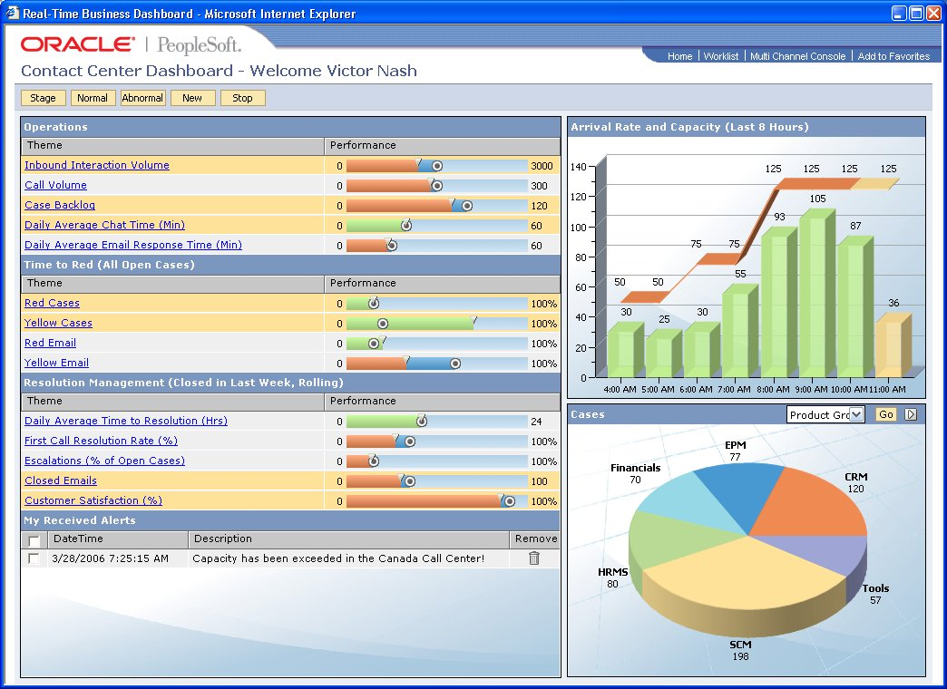
BAM | User Experience

Slide 36
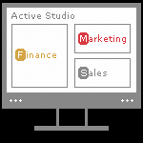
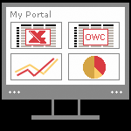
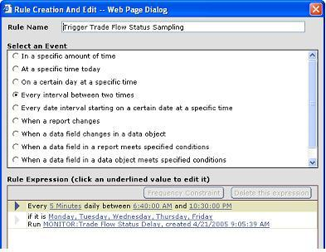
BAM Active Studio
Template-Driven Design
User Defined Alert Rules
Integrated reporting and analytics
Complex, multi-category business reporting
Multiple displays in a single report like charts, Graphs, Lists, Columnar, KPI’s, Excel, Custom Content

Slide 37
Oracle Business Rules
Making dynamic decisions

Slide 38
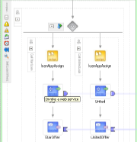
What is OBR or simply rules
Rules are a way to specify conditional actions or policies
  If salary is less than $10,000 then deny loan application
  If miles flown is greater than 50,000 then grant gold status
Rules
  Can be represented as simple if-then statements
  Are declarative, not procedural
  Often generated by GUI programs
Rules executed on Rules Engines
  Facts are input
  Facts analyzed per Rules
  Actions conditionally executed
  or results returned
facts
Rules
Engine
results
Application

Slide 39
OBR Features
Dynamic Fact Generation
Rules are conceptually simple
  Facts: Data concerning the world
  Rules: if (<condition involving Facts>) then <Actions>
  Actions: Simple returns or direct action calls
  Example: If (quantity >= 12) then
  give 20% discount
An action can be the generation of a new fact
  This is called inferencing
  Example: If (GPA > 3.5 and SAT > 1400) then
  create scholarship-eligible Fact
facts
Rules
Engine
results
facts

Slide 40
OBR Features Cont…
Rules Programming Models
Rules "consulted" by applications
  Procedural logic asserts facts to Rules engine
  Results engine returns results
  Procedural logic calls actions
Rules can call actions directly
  Procedural logic asserts facts to engine
  Rules engine calls actions directly
  Especially attractive for notifications
  Can access database info, etc.
Claim
facts
Rules
Engine
results
Don't
pay
Application
Logic
fraud
alert

Slide 41
Registry
Publication, categorization, and discovery of services across the enterprise

Slide 42
What Is The Registry?
Provides a “System of Record” for managing all SOA artifacts across the enterprise
Essentially a searchable “yellow pages” of services, providers and related resources
Compliant with OASIS UDDI (Universal Description, Discovery and Integration) v3 specification
Not a container for the services
  Stores metadata and references to services only

Slide 43


Core Value Proposition
Enables publication, categorization and discovery of services across the enterprise
Enables providers to expose and advertise service offerings
Allows consumers to find, access and/or invoke services that meet defined criteria
  Services categorized using taxonomies
  Alerts when a service changes or new service is added
A registry is a strong mechanism for promoting reuse and preventing unnecessary reinvention

Slide 44
B2B
Business-to-business integration
http://ias.us.oracle.com

Slide 45

Oracle Integration B2B
An enterprise-strength infrastructure for the exchange of information, electronically, between enterprises.
An integral component of the Fusion Middleware
Comprehensive Trading Partner Management
Extensive protocol support
Easy to use wizard based UI
Built on a standards based scalable architecture
Managed through Oracle Application Server Control
Oracle Integration B2B
Trading Partner Management
Exchanges
RNIF, AS2, ebMS, MLLP
Security
MIME, SMIME, XMLDSig, XMLEncrypt
Transports
HTTP (s), File, FTP (s), TCP/IP, SMTP, IMAP
Document Management
UN/EDIFACT, X12, X12N, HL7, HIPAA, NCPDP Script, UBL, UCCnet, OAG, PIP BD, cXML, W3C XML Schema, Custom
Certified eBusinessReady™ for AS2 EDI/XML Interoperability

Slide 46
Extensive Protocol Support
Extensive protocol support to enable the deployment of industry-recognized standards
  Document: UN/EDIFACT, X12, X12 Property & Casualty,
  HIPAA & HIPAA External code list, X12N Life & Annuity, X12N Healthcare, NCPDP Script, UCCnet, OAG, PIP BD, cXML, any W3C XML Schema, custom, …
  Transport: HTTP, HTTPs, SMTP, IMAP, File, FTP, FTPs, ...
  Packaging: MIME, SMIME, XMLDSig, XMLEncrypt
  Exchange: RNIF, AS2, ebMS, MLLP, ..
  Process: RosettaNet PIP
Certified eBusinessReady™ for AS2 EDI/XML Interoperability

Slide 47
D E M O N S T R A T I O N
SOA OrderBooking Demo

Slide 48

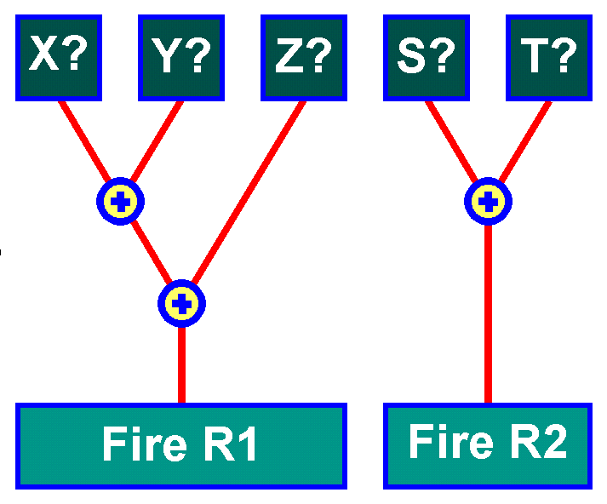

Order Booking SOA Demo
Focus on ESB, Rules, Workflow, BPEL
SHOPPING PORTAL
ESB
Order Booking BPEL PROCESS
receive
Order DB
Insert Order
Rules
repository
getCustInfo
EJB 3.0
Customer service
Rules
Engine
Decision
Service
Manual
Review
?
Rule Author
Approval
(Rich Workflow)
Rapid Dist.
Web Services Interface: XML, SOAP, WSDL, WSIF
Select Mfr
invoke
invoke
5-15 min
ESB
receive
receive
Product
Suppliers
Fulfill Order
FedEx
USPS
Notify Cust
Notification
Service
end

Slide 49
Oracle Differentiators
1
Comprehensive breadth of platform
Comprehensive lifecycle support
Unified products with consistent experience
Hot pluggable based on open standards
2
3
4

Slide 50
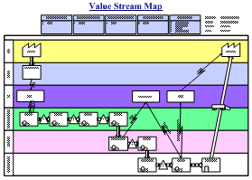
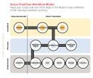



Process Modeling
Business Analyst
Business Process Model
Business Modeling
Functional Analyst / Architect
Shared Metadata
Logical Design
Technical Modeling
Application/Integration Developer
Physical Design

Slide 51
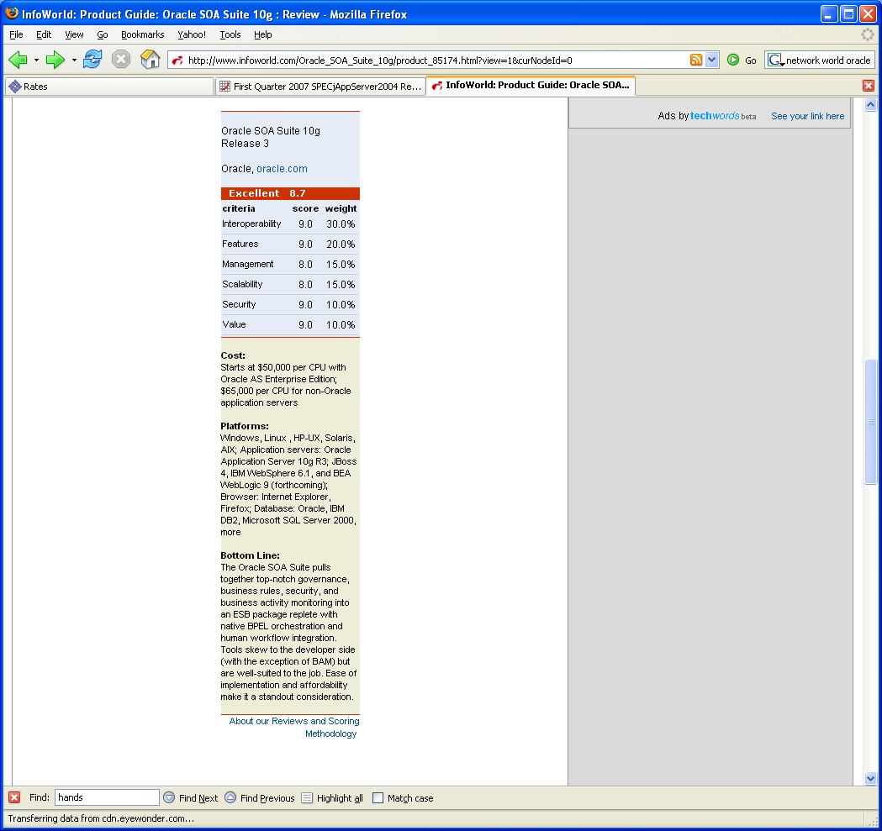
SOA Suite 10.1.3 - Already Winning Awards
Independent Evaluation by InfoWorld, Published Jan 2007
“Oracle SOA Suite - Excellent”
“I found Oracle SOA Suite, hands down, the most comprehensive and easy to use product on the market today.”
“When it comes to message routing and services orchestration, Oracle SOA Suite meets or exceeds most needs for governance, security, insight, and optimization at a price that’s hard to beat.”
“Bottom Line: The Oracle SOA Suite pulls together top-notch governance, business rules, security, and business activity monitoring into an ESB package replete with native BPEL orchestration and human workflow integration”
Slide <number>

Slide 52
Q
&
A

